Slide 1
QTL mapping and GWAS Bioinformatics Applications (PLPTH813)
Sanzhen Liu
3/25/2025

Slide 2
Outline
QTL mapping
Genome-wide association study (GWAS)
Acknowledgements: some slides were prepared by Dr. Lei Li.

Slide 3
What is the goal to perform QTL or GWAS?

Slide 4
QTL mapping
A Quantitative Trait Locus (QTL) is a genomic locus that genetically influence variation in a phenotype of a quantitative trait.
Population
A genetic linkage map or a physical map would be helpful to identify QTLs and locate them on a map
traits of interest: phenotyping
Certain platform: genotyping
QTLs

Slide 5
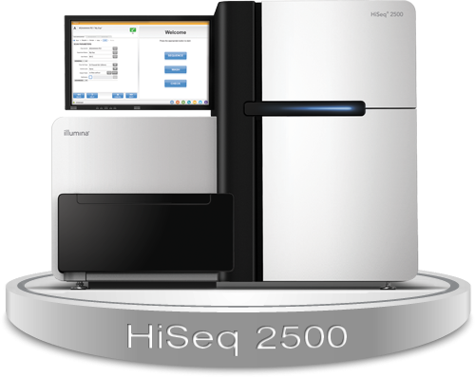
Sequencing technology is an excellent tool to genotype many loci in parallel
ATCGCTGCCGATCTGCGTCATACGGAATCGTCGGCTTCAG
ATCGCTGCCGATCTGCGTGATACGGAATCGTCGGCTTCAG
ATCGCTGCCGATCTGCGTCATACGGAATCGTCGGCTTCAG
ATCGCTGCCGATCTGCGTGATACGGAATCGTCGGCTTCAG
ATCGCTGCCGATCTGCGTCATACGGAATCGTCGGCTTCAG
ATCGCTGCCGATCTGCGTGATACGGAATCGTCGGCTTCAG
ATCGCTGCCGATCTGCGTCATACGGAATCGTCGGCTTCAG
-----------------C/G--------------------
1/0
Genotyping score
Marker

Slide 6
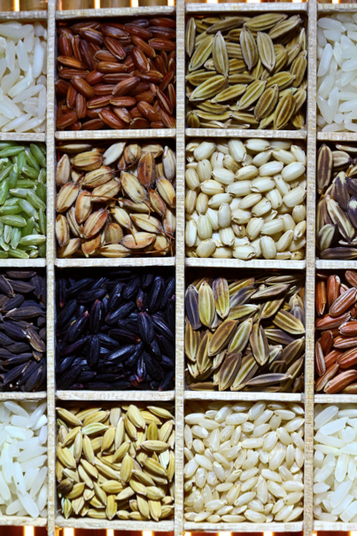
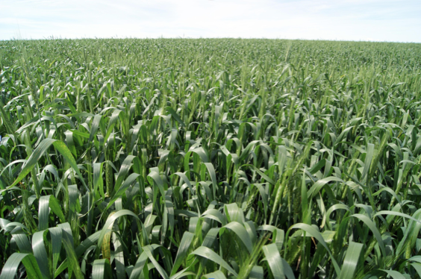
Phenotyping
agphd.com
wikimedia.org
Notes:
colors; shape; size; weight

Slide 7
Mapping populations
Parents
X
F1, F2
Recombinant Inbred Lines
Double haploid (DH) lines
haploid induction
genome doubling
...
DH lines

Slide 8
Mapping a causal genetic controlling component (X)
Map/Marker
A B
C D
Recombination
1
0
Chromosome
X
…1…1… …1…1…
…0…0… …0…0…
Genotype

Slide 9
Mapping a causal genetic controlling component (X)
Mapping population
A B C D
X
X’
1 1 1 1
1
35
0 0 0 0
0
Mapping result
3
1 1 1 0
1
24
0 0 0 1
0
A B X C D
12
1 1 0 0
1
45
1 0 0 0
0
18
0 1 1 1
1
20
Genotype
Phenotype
Phenotype

Slide 10
Approach 1: t-test or ANOVA
Based on the genotype data, individuals are divided into groups
Perform t-test or ANOVA
Repeat for all markers
(use t-test if only two groups exist)
genotype
phenotype
1
35
1
24
1
20
1
45
0
3
Pros:
Simple; No maps required
Cons:
Individuals with missing data are excluded
Reduced power when markers are in a low density
0
18
0
12

Slide 11
Approach 2: Interval mapping (IM)
QTL
Assume a single QTL model (QTL at a certain genetic position)
Determine the confidence of each QTL model
Scan the whole map (interval by interval)

Slide 12
Interval mapping – estimate genotypes
10 cM
16 cM
30 cM
Estimate genotypes:
each estimated genotype is associated with a certain probability
Genetic linkage map
M1
QTL
M2
Genotype
?
0
0
0
1
1
1
1
?
…
?
0 w/high prob
?
?
1 w/high prob
?
1 w/high prob
?
?
…
0
0
?
1
1
?
1
0
0
…
Assume a single QTL model (QTL at a certain genetic position)
Notes:
Assumptions:
1. Crossovers occurred at random along the chromosome
2. The probability of a crossover at one position along the chromosome was independent of the probability of a crossover at another position.

Slide 13
Genetic linkage map
Describe the linear order and genetic distance of markers within a linkage group
Marker distance
Marker score
1cM
M1 0 1 0 1 1 1 0 1 0 0 1 1 ...
Linkage Group
M2 0 1 0 1 1 1 0 1 0 1 1 1 ...
2cM
M3 0 1 0 1 0 1 0 0 0 1 1 1 ...
2.5cM
1cM
M4 0 1 1 1 0 1 0 1 0 1 1 0 ...
M5 0 1 1 1 0 1 1 1 0 1 1 0 ...
Recombination frequency: the percentage of recombinant gametes produced in a cross
Recombination frequency (r) = #recombinants / total x 100%
1 centimorgan (cM) apart on a genetic map indicates approximately 1% of recombination events.

Slide 14
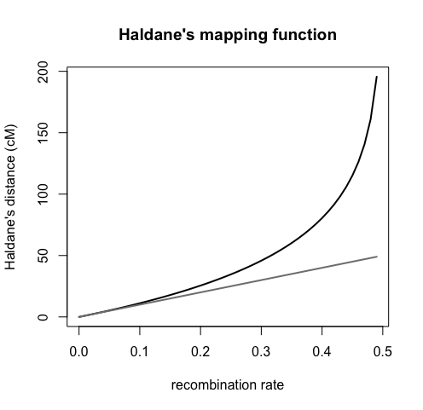
Mapping function
Conversion between recombination frequencies and genetic distances
Different formula (Haldane and Kosambi)
Haldane’s mapping function
r = recombination rate (0-0.5)
d = distance in Morgans
Notes:
r <- seq(0, 0.4999, by=0.01)
d <- -0.5*log(1-2*r)
cM <- d*100
plot(NULL, NULL, xlim=range(r), ylim=range(cM),
xlab="recombination rate",
ylab="Haldane's distance (cM)",
main="Haldane's mapping function")
lines(r, cM, lwd=2)
lines(r, 100*r, col="gray50", lwd=2)
#abline(a=0, b=1)

Slide 15
Interval mapping – estimate genotypes
10 cM
16 cM
30 cM
M1
QTL
M2
Genotype
?
0
0
0
1
1
1
1
?
…
0
0
0
0
1
1
1
1
0
…
0
0
?
1
1
?
1
0
0
…
infer genotypes
each estimated genotype is associated with a certain probability
Notes:
Assumptions:
1. Crossovers occurred at random along the chromosome
2. The probability of a crossover at one position along the chromosome was independent of the probability of a crossover at another position.

Slide 16
Estimate likelihood of a QTL model
Maximum likelihood estimates (MLE)
Prob(pheno data | geno data; a QTL at a given position)
e.g., EM algorithm, Haley-Knott regression (HK)
No QTL Likelihood
Prob(pheno data | geno data; no QTL)

Slide 17
LOD (logarithm of the odds)
Prob(pheno data | geno data; a QTL at a given position)
Prob(pheno data | geno data; no QTL)
LOD = log₁₀
LOD = log₁₀ likelihood ratio, comparing a single-QTL model to the “no QTL anywhere”.
The LOD score is a measure of the strength of evidence for the presence of a QTL at a particular location.
LOD scores must be closer to 3 before they will generally be deemed interesting. - Broman, Lab Animal, 30(7):44–52, 2001
Notes:
the likelihood of a QTL at a location is 1000 times as that of no QTLs

Slide 18
LOD = 3?
Prob(pheno data | geno data; a QTL at a given position)
Prob(pheno data | geno data; no QTL)
LOD = log₁₀

Slide 19
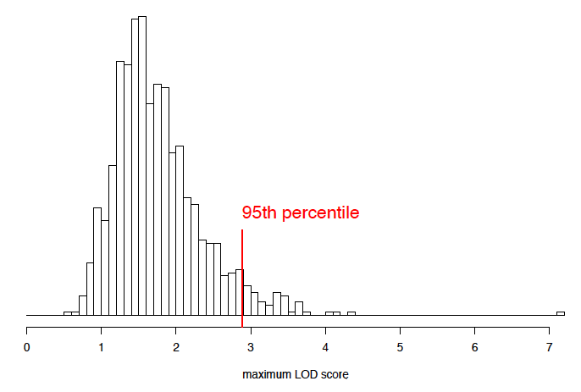
Permutation tests to infer a LOD threshold
Permute/shuffle the phenotypes; keep the genotype data intact.
QTL analysis and get the max(LOD) (maxLOD₁)
Repeat 1000 times to have (maxLOD₁, maxLOD₂, … maxLOD₁₀₀₀)
The 95th percentile of MaxLOD is a genome-wide LOD threshold.

Slide 20
Question
Can we perform a QTL study on a human population?

Slide 21
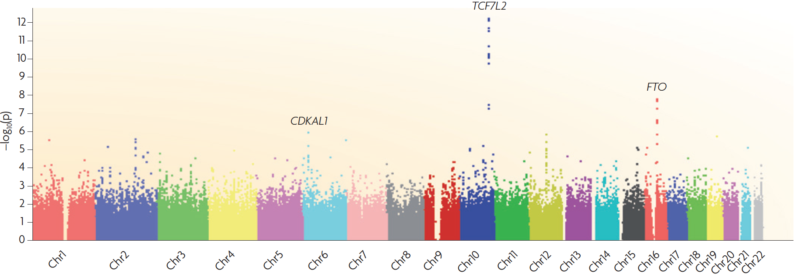
Genome-wide association study (GWAS)
GWAS is the study to correlate a great number of genomic variants with a large number of individuals to identify variants that are significantly associated with the phenotype of interest.
Goal: to identify causal variants

Slide 22
GWAS inputs
Population
Genotyping data of a good number of markers of individuals in a population
Phenotyping data of individuals from a population

Slide 23
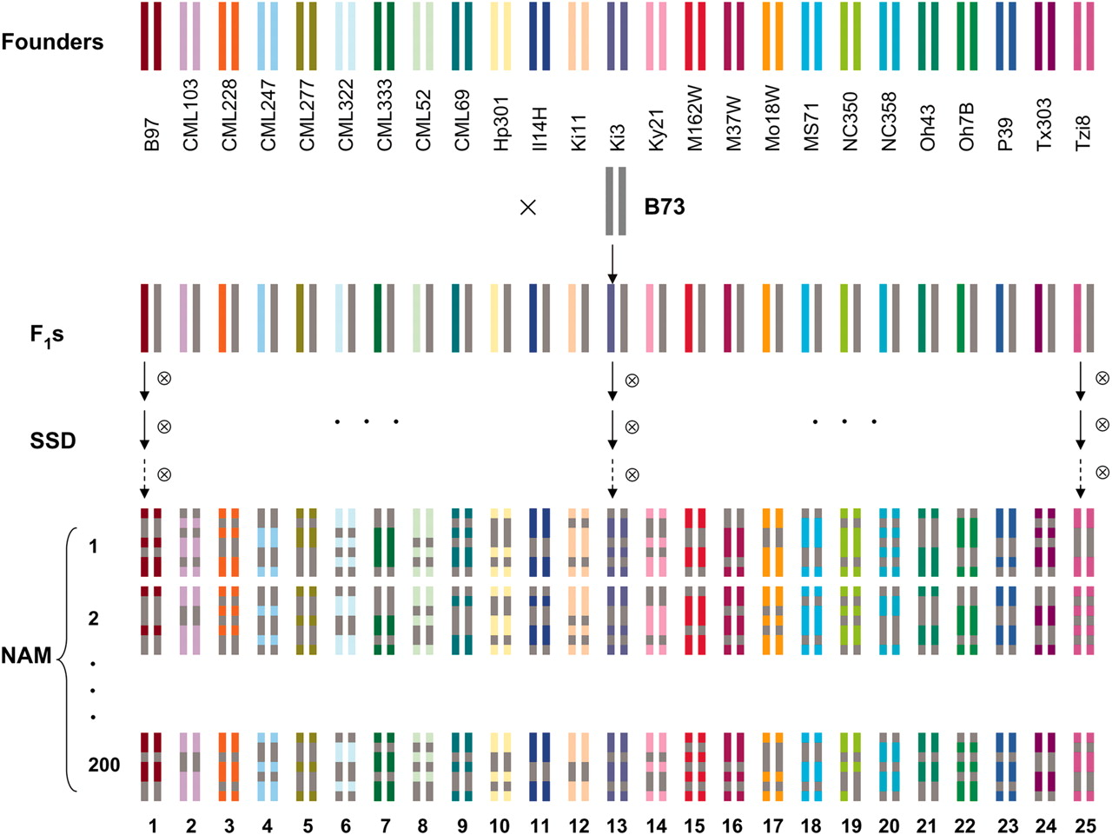
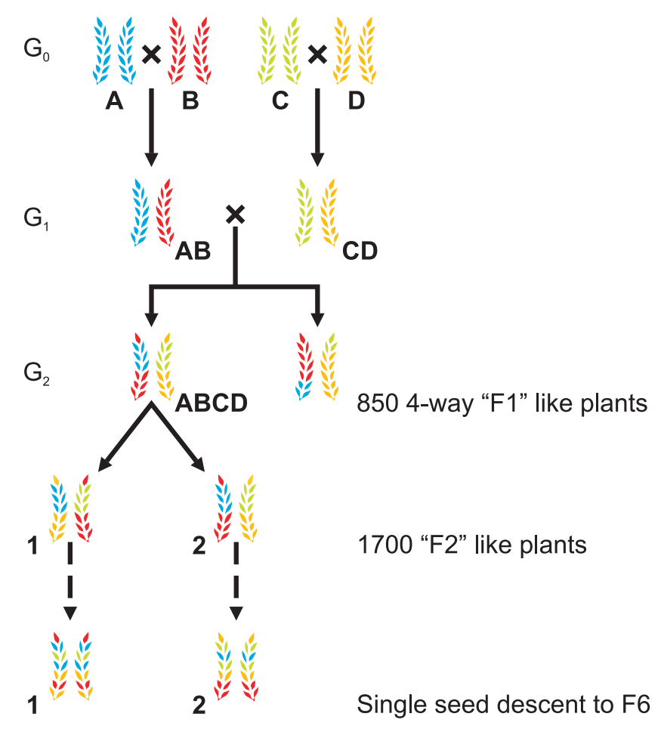
Mapping populations
Natural population
Diverse individual plant lines/animals/human beings.
Multi-parent crosses
Nested association mapping lines (NAM)
Multi-parent Advanced Generation Inter-Cross (MAGIC)
Yu et al., Genetics 2008;178:539-551
Huang et al., Plant Biotechnology Journal 2012; 10:826–839

Slide 24
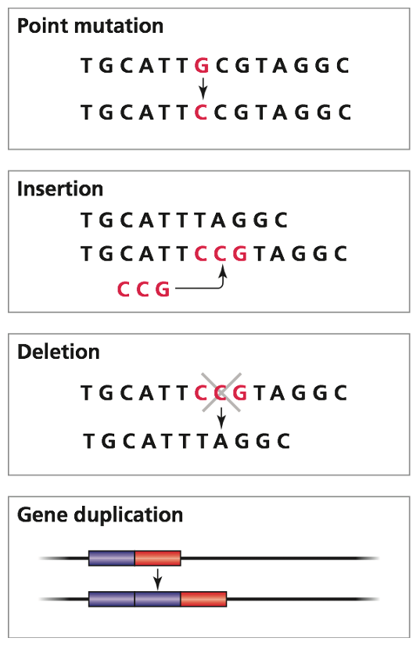
Marker and causal variants
bi-allelic SNPs are most commonly used markers for GWAS
Why SNPs can be used to identify an association with a phenotype even causal variants are not typed?

Slide 25
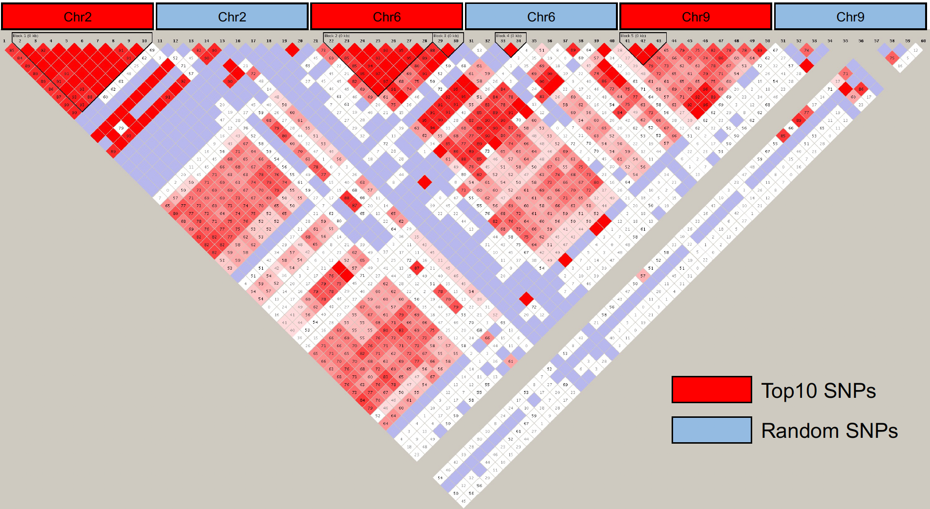
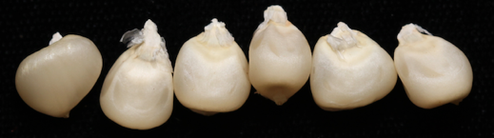
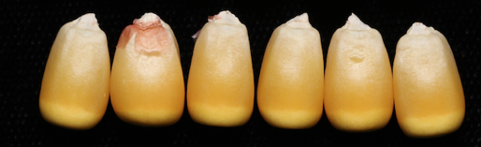
Linkage disequilibrium (LD)
Linkage disequilibrium (LD): a non-random association of alleles at different loci; genotyping data at two loci have some level of correlations
Individual 1
chr2
chr6
chr9
2
3
Markers with a strong LD are not necessarily in the same chromosome.
4
5
6
7
8
M1
M2
M3

Slide 26
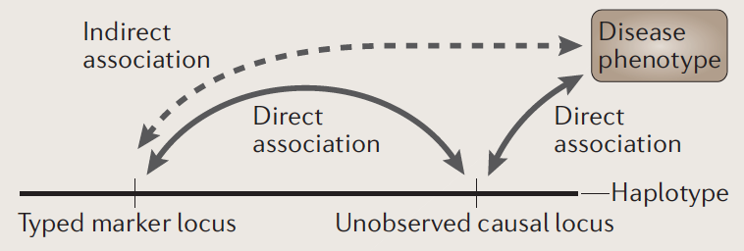
Linkage disequilibrium (LD)
Balding et al., Nature Review Genetics, 2006, 7:781

Slide 27
Genotyping data and filtering
Typically only bi-allelic markers are used.
Of two alleles, the allele with a smaller frequency is the minor allele. Its frequency is minor allele frequency (MAF). A MAF cutoff is needed to filter SNPs (e.g., 1%).
Filter out markers with high missing data (e.g., 30%).
Imputation can reduce missing data.
Estimated
power
MAF

Slide 28
Statistical test for each genomic variant (e.g., SNP)
y: trait data
: all non-variant fixed effect
: variant effects
This model is not sufficient to explain phenotypic data.

Slide 29
Spurious associations
Early flowering
Later flowering
population 1
population 2
Different proportions of sub-populations in two groups lead to spurious associations.
Modified from Balding et al., Nature Review Genetics, 2006, 7:781
Notes:
simply population 1 were represented at a higher proportion in the group of "early flowering".

Slide 30
Population structure (Q)
Population structure (Q)
Confounding structure leads to false positive.
Define a set of markers
Population structure:
e.g., Principal Component Analysis (PCA)
Fixed effect

Slide 31
Q + K model explains more phenotypic variants
Population structure (Q)
Kinship (K) - cryptic relatedness: the degree of genetic relatedness between individuals in the study.
Mixed linear model (MLM)
Random effect
Notes:
Population structure and kinship are both confounding factors in GWAS since they produce covariance between individuals' phenotype values. Yet the dimensionality of these two processes are different. Population structure is a low dimensional process embedded in a high dimensional space so that a relatively small number of principal components represent the underlying population genetics [2], [27], [30]. Therefore, a small number of principal components can be adequate to account for population structure in GWAS datasets [3], [1]. Conversely, kinship is a high dimensional process since small sets of individuals are very closely related while being unrelated to the remaining individuals. Consider an idealized example of independent parent-offspring duos so that the coefficient of coancestry between parent and offspring is 0.5, and 0 between all other individuals. It follows directly that the corresponding coancestry matrix is block diagonal and the eigen-spectrum has a long tail so that all eigen-values are nonzero. Thus kinship is a high-dimensional process that cannot be captured by a small number of principal components.

Slide 32
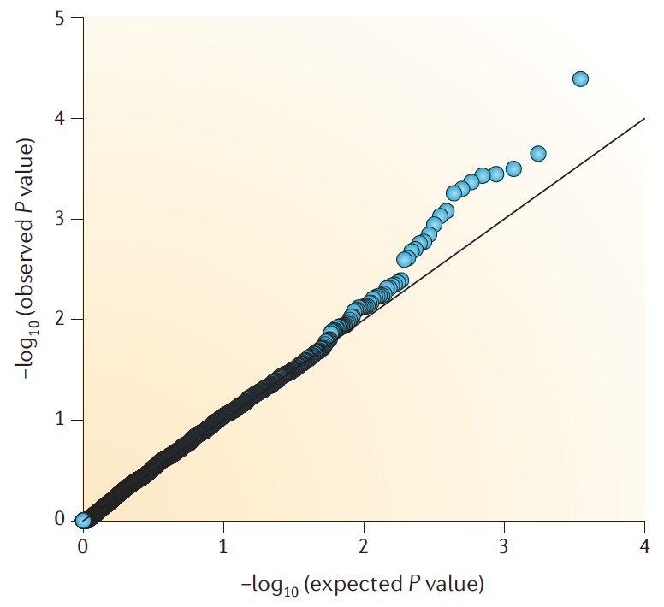
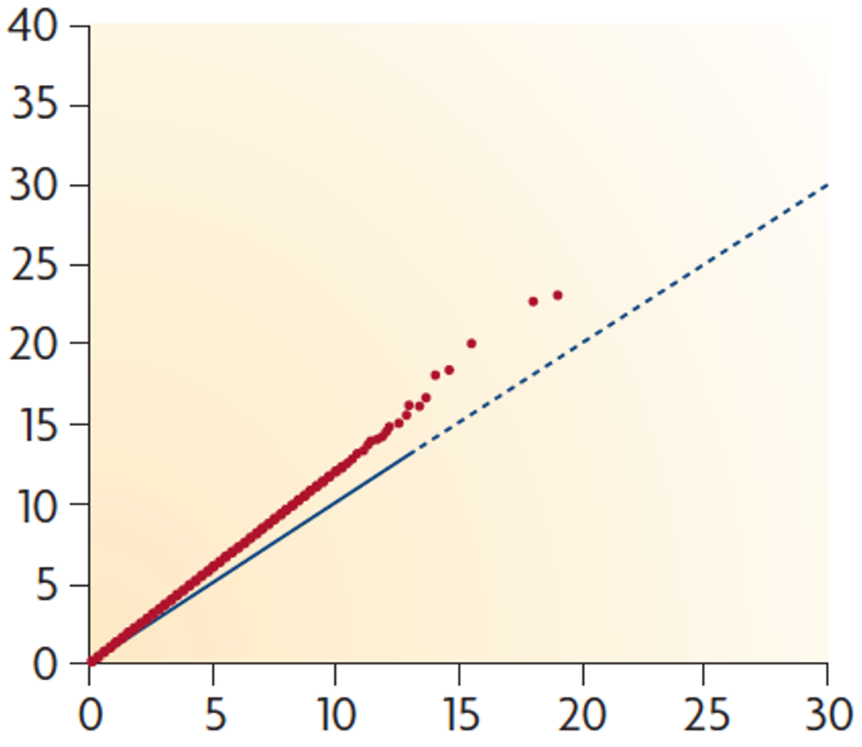
quantile-quantile (Q-Q) p-value plot
Balding et al., Nature Review Genetics, 2006, 7:781
Notes:
In a Q-Q plot from a genome-wide association study (GWAS), each dot represents the expected versus observed p-values for a single nucleotide polymorphism (SNP).
expected p-value = (rank of SNP in the data set) / (total number of SNPs being tested)

Slide 33
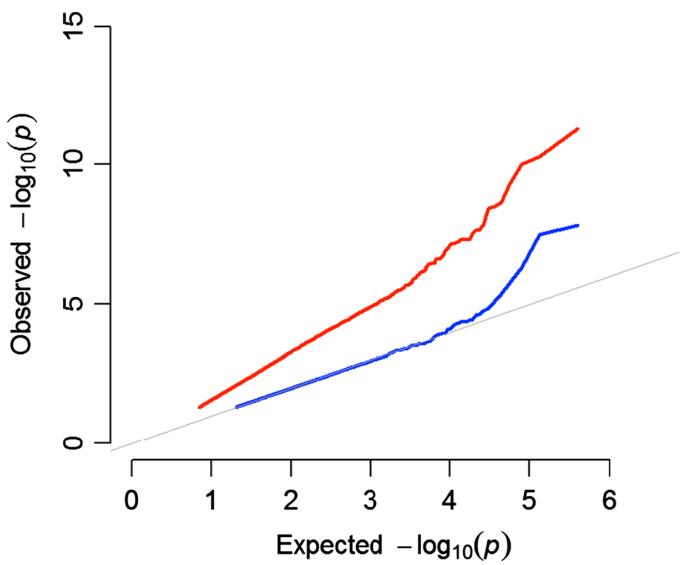
Mixed linear model (Q+K MLM)
The mixed model (blue) dramatically reduces inflation of p-values

Slide 34
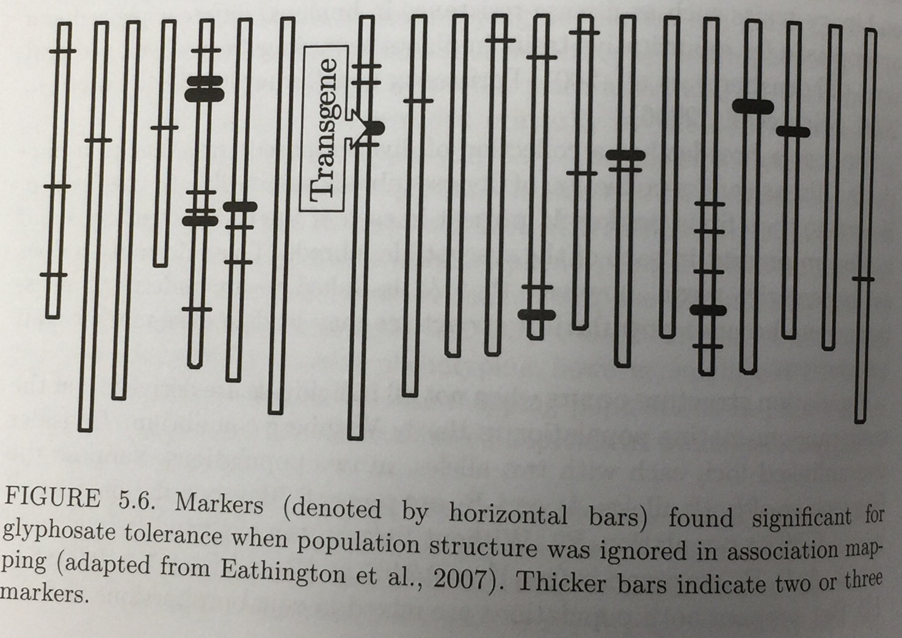
GWAS w/o accounting for population structure
750 soybean inbred lines
49 markers on 15 chromosomes
Bernardo R, Quantitative traits in plants
Bernardo, 2010, Breeding for quantitative traits in plants
Eathington et al., 2007

Slide 35
Manhattan plot
McCarthy et al., Nature Review Genetics, 2008: 9:356-369
association does not imply causation

Slide 36
GWAS p-value threshold
5×10⁻⁸ has become a standard (Human GWAS)
naive Bonferroni correction (conservative due to the assumption that every genetic variant tested is independent of the rest)
false discovery rate procedures
permutation based-approaches
Bayesian approaches
0.05 / # markers
European Journal of Human Genetics, 24:1202–1205 (2016)

Slide 37
k-mer GWAS
(k=3)
sequence
Occurrence counts of k-mers from whole genome sequencing reads
A T G G C G T
3-mer
ATG
TGG
GGC
GCG
CGT
Rahman et al., Elife, 2018
Voichek et al., Nature Genetics, 2020

Slide 38
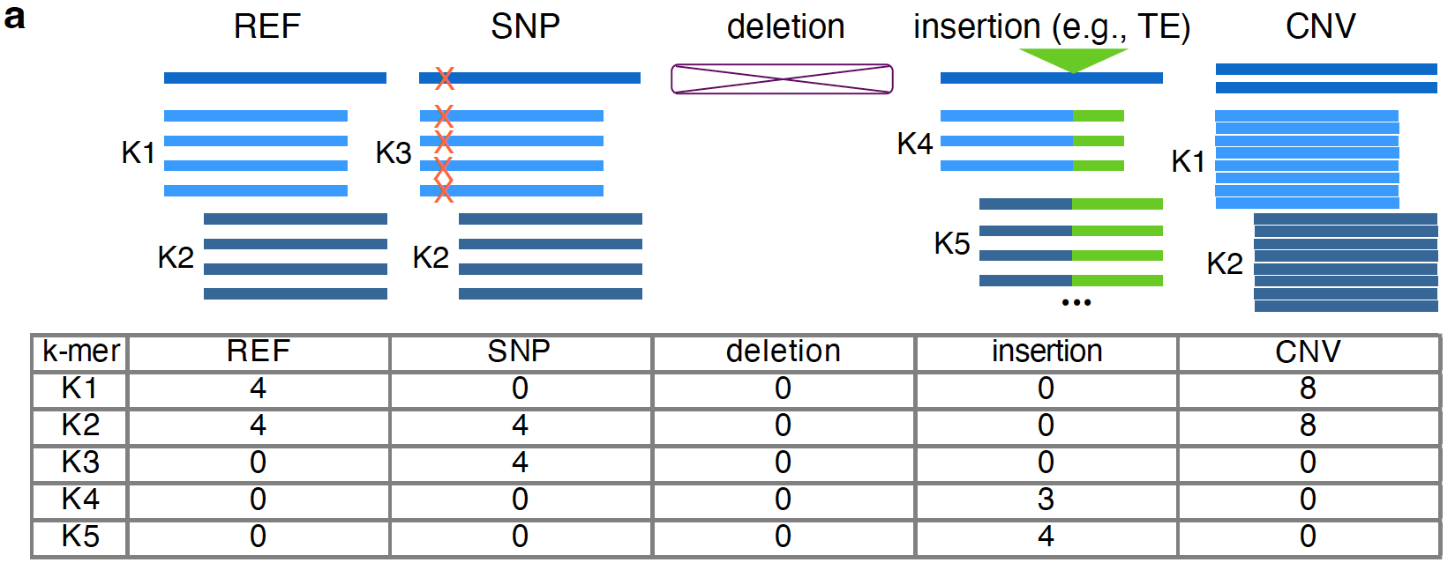
SHORT k-mer markers represent a wide range of genomic variants
He et al, 2024, Plant J

Slide 39
What is the difference between QTL and GWAS?

Slide 40
Comparison between QTL and GWAS
Attribute | QTL mapping | Association genetics
Populations | Typically from biparental lines; Limited recombination | from diverse lines, taking advantage of historic recombination
Markers for genome coverage | No high-density markers required | high-density markers required
Resolution | Limited | High

